Slide 1
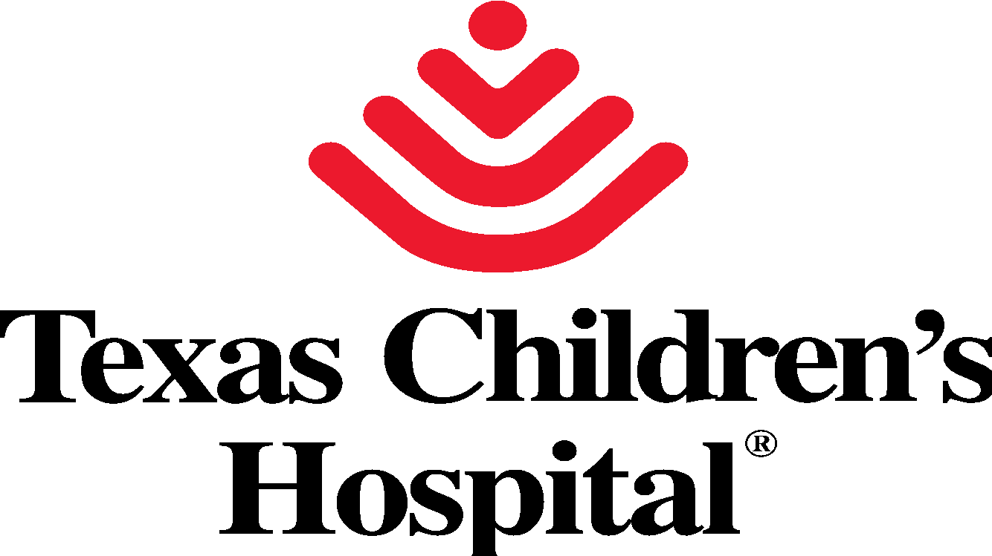
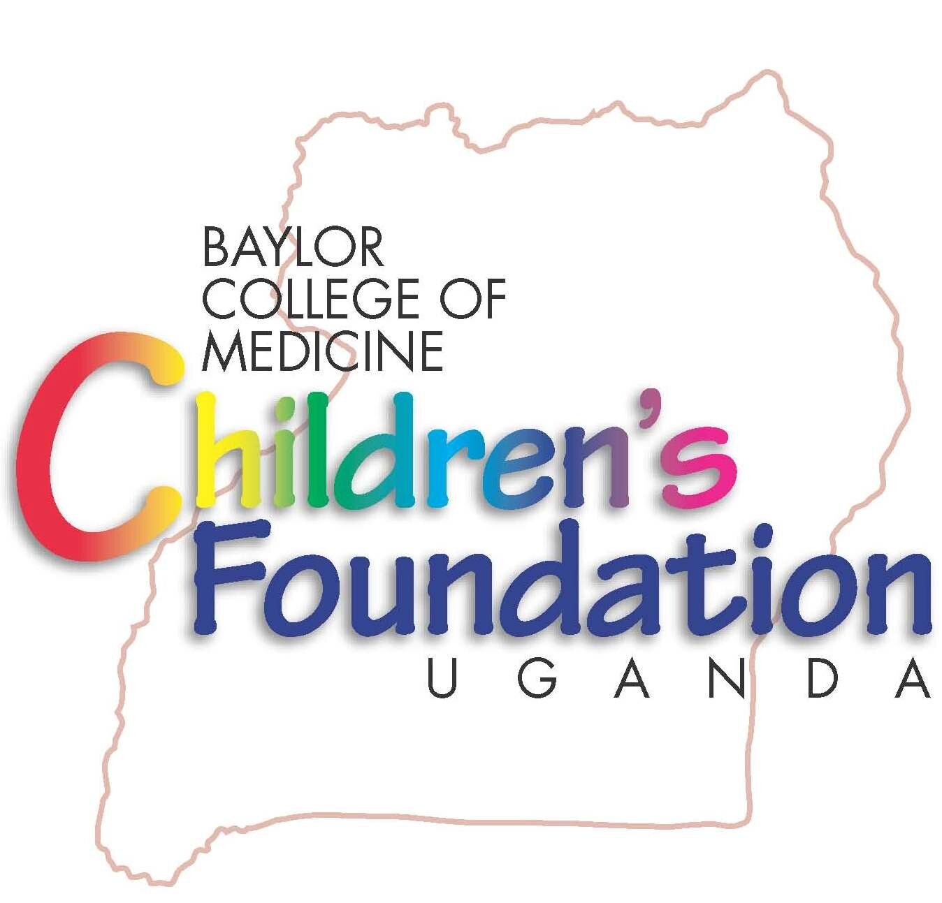
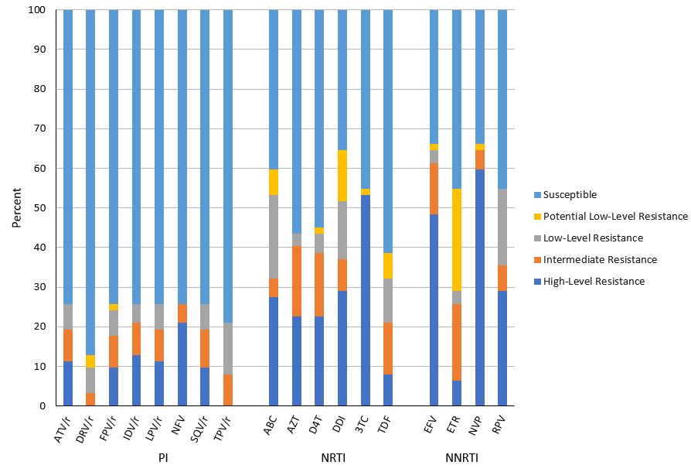
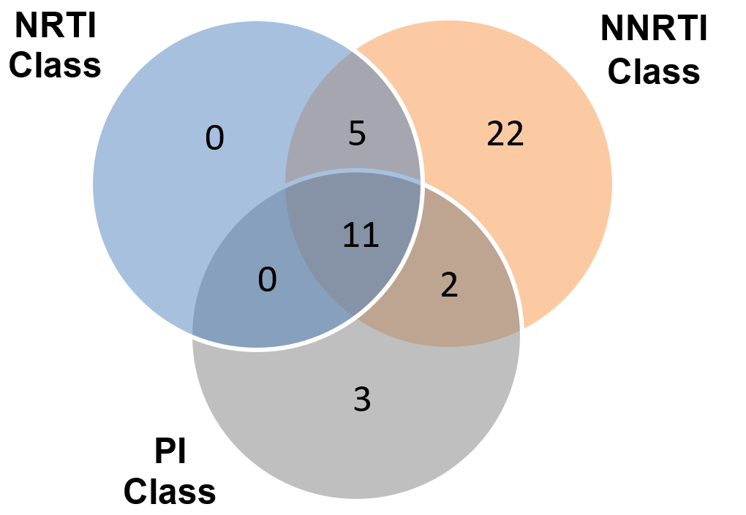
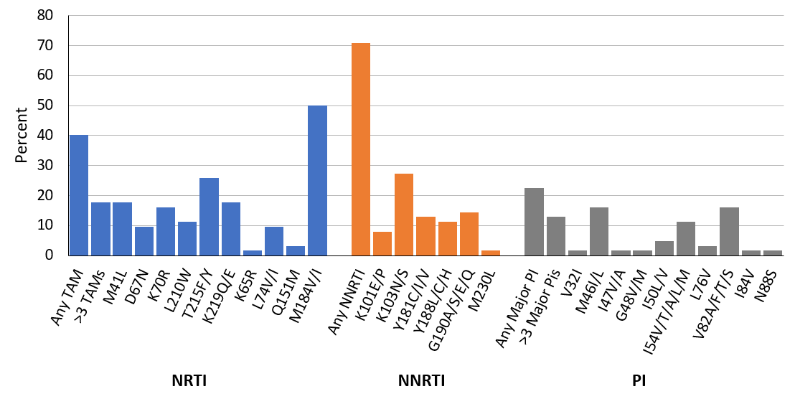
Third-Line Compromise: Characterization of Drug Resistance in Ugandan Children and Adolescents Failing Second-Line Antiretroviral Therapy
Michelle Javier¹, Peter Elyanu², George P. Akabwai², Amanda Small¹, Adeodata Kekitiinwa²
¹Baylor College of Medicine, ²Baylor College of Medicine Children’s Foundation – Uganda
Background
HIV drug resistance (HIVDR) has become a focal point in the discussion to end AIDS by 2030.
Children and adolescents living with HIV face unique challenges that increase the risk of HIVDR:
Prolonged ART duration
High pill burdens with frequent dose alterations
Potential for inadequate drug dosing
High rates of failure due to disclosure, adolescence
In Uganda, 95,000 children are living with HIV and a mere 39.3% are virally suppressed.
Uganda has one of the highest rates of transmitted drug resistance worldwide, with 35% of newly diagnosed infants demonstrating NNRTI resistance.
However little is known about resistance patterns of children and adolescents failing second-line ART.
Results
Results
Table 1. Patient Characteristics
Figure 3. Level of Resistance by Drug at Second-Line Failure
 | All patients (n=62)
Age, median (IQR) | 16 (14, 18)
Female gender, n (%) | 32 (51.6)
Weight in kg, median (IQR) | 42.9 (35.5, 52)
At Time of Resistance Panel
WHO Stage Stage 1 Stage 2 Stage 3 Stage 4 | 43 (69.4) 2 (3.2) 8 (12.9) 9 (14.5)
CD4, mean (IQR)‡ | 166 (48, 372)
Viral Load in copies/mL, median (IQR)* | 99,183 (30,100; 251,650)
Most Common ARV Regimens, n (%) ABC/3TC/ATV/r ABC/3TC/LPV/r AZT/3TC/ATV/r TDF/3TC/ATV/r | 13 (21.0) 24 (38.7) 7 (11.3) 10 (16.1)
Number of IAC sessions, median (IQR) | 9 (3, 13)
Time on PI-based regimen in months, median (IQR)* | 42.5 (24.5, 57)
Third Line Regimen Given, n (%) | 17 (27.4)
Outcome, n (%) Transferred Lost to Follow-Up Death | 4 (6.5) 2 (3.2) 8 (12.9)
Abbreviation: IAC, intensive adherence counseling.
*Calculation based on 60 patients with available data.
‡Calculation based on 58 patients with available data.
Sixty-nine percent of patients (43/62) had significant resistance to at least one ART class.
Of these, 16% (7/43) had significant dual-class resistance and 26% (11/43) had significant resistance to all three classes.
Intermediate and high-level resistance was observed in 19% (12/62) of patients to ATV/r and 19% (12/62) to LPV/r.
At least low-level resistance was present in 29% (18/62) of patients to ETR and 10% (6/62) to DRV/r.
Objectives
To describe the pattern of drug resistant mutations (DRMs) in Ugandan children and adolescents living with HIV, failing second-line ART.
Figure 1. Distribution of Significant Class Resistance At Second-Line Failure
Methods
Retrospective cross-sectional study analyzing patients between January 2010 and September 2019 with the following*:
≤ 20 years of age
Drug resistance testing after failing second-line ART, defined as VL > 1000 copies/mL at least 6 months after initiating second-line
Stanford University HIVdb Program version 8.9-1 was used for mutation reporting and interpretation.
For each ART class, a composite genotype susceptibility score (GSS) was calculated. Composite GSS scores ≤1, ≤2.5, and ≤5 indicated significant ART class resistance for NRTI, NNRTI and PI, respectively.
*One patient with major PI mutations after 3 months of second-line ART was included in the analysis.
Conclusion
Children and adolescents living with HIV are at high risk of developing DRMs, a hurdle in attaining viral suppression.
Our cohort of Ugandan children and adolescents demonstrated significant rates of resistance to entire classes of ARTs as well as the compromise in the susceptibility of commonly-used third-line drugs.
In order to reach the UNAIDS 95-95-95 targets, further investigation is needed to elucidate factors associated with DRMs, to optimize the timing and frequency of resistance testing, and to improve adherence in children and adolescents living with HIV in Uganda.
Figure 2. Frequency of Drug Resistant Mutations At Second-Line Failure

